Slide 1
Refactoring and Integration Testing or
Strategy, introduced reliably by TDD
The power of automated tests

Slide 2
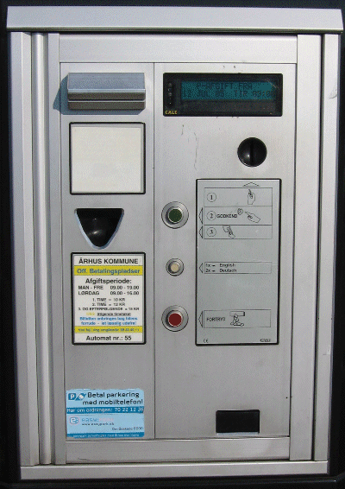
Two product variants
Alphatown and Betatown
  Four models to handle this
    compositional proposal has nice
    properties...
How do we introduce it?
CS @ AU
Henrik Bærbak Christensen

Slide 3
Change by addition
I state:
Change by addition, not modification
because
  addition
    little to test, little to review
    little chance of introducing ripple-effects
  modification
    more to test, more to review
    high risk of ripples leading to side effects (bugs!)
CS @ AU
Henrik Bærbak Christensen

Slide 4
The Problem Statement
But I have to modify the pay station implementation in order to prepare it for the new compositional design that uses a Strategy pattern
☹ Change by modification
Problem:
  How to reliably modify PayStationImpl?
  How can I stay confident that I do not accidentally introduce any defects?
CS @ AU
Henrik Bærbak Christensen

Slide 5
Take Small Steps
I will stay focused and take small steps!
I have two tasks
  Redesign the current implementation to introduce the Strategy and make AlphaTown work with new design
  Add a new strategy to handle Betatown requirements
... and I will do it in that order – small steps!
CS @ AU
Henrik Bærbak Christensen

Slide 6

Refactoring
Definition:
Refactoring is the process of changing a software system in such a way that is does not alter the external behaviour of the code yet improves its internal structure.
Fowler, 1999
CS @ AU
Henrik Bærbak Christensen

Slide 7
Iteration 1
Refactoring step

Slide 8
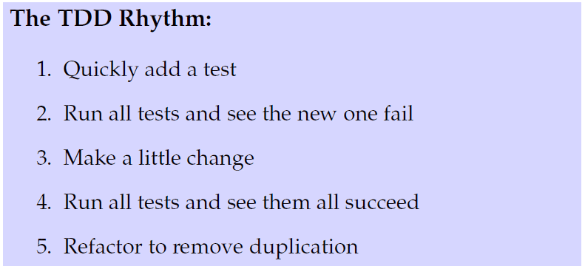
The Rhythm
Refactoring and the rhythm
Same spirit, but step 1: refactor
CS @ AU
Henrik Bærbak Christensen

Slide 9
The new way ☺
CS @ AU
Henrik Bærbak Christensen

Slide 10
Warning
The next slide section reflects the book and how I worked for many years. It works fine, but…
Today – I do it differently.
I simply enter the solution right away in Eclipse:
CS @ AU
Henrik Bærbak Christensen

Slide 11
And then what happens?
Eclipse will complain about a compile error, and come with suggestions to how to fix it.
So – I just choose all the right fixes!
Result: Eclipse does most of the typing ☺
Morale: Start with what you want ☺
(If you can – sometime you cannot ☺)
CS @ AU
Henrik Bærbak Christensen

Slide 12
The old way ☺
CS @ AU
Henrik Bærbak Christensen

Slide 13
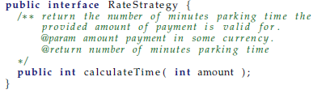
Step i
Introduce RateStrategy interface
  green bar = new interface compiles
  (compiling is also a success ☺)
CS @ AU
Henrik Bærbak Christensen

Slide 14
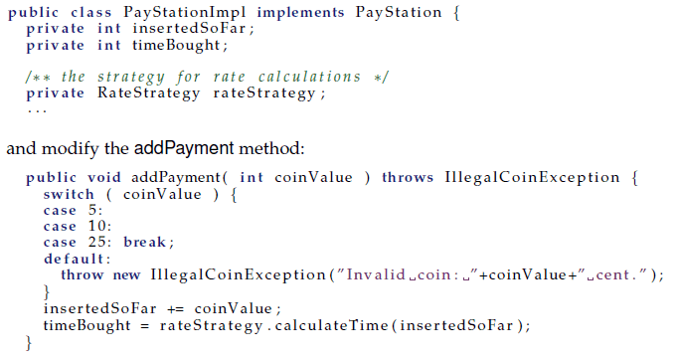
Step ii
Refactor to delegate to RateStrategy instance
  introduce reference + refactor calculation
CS @ AU
Henrik Bærbak Christensen

Slide 15
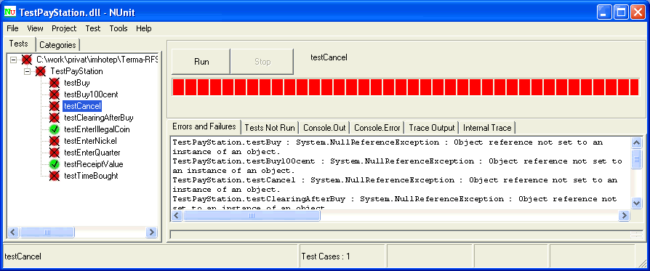
2. See that it fails
Why is it important to see it fail?
CS @ AU
Henrik Bærbak Christensen
Notes:
I have sometimes been editing the wrong source code (a copy or wrong workspace)

Slide 16
3. Make a little change
Introduce a proper constructor and
Refactor the tests code to invoke it...
  (Now it is really good that I refactored the creation of the pay station instance into a @Before method!)
However – no implementation of LinearRateStrategy...
What TDD pattern would you suggest?
CS @ AU
Henrik Bærbak Christensen
Notes:
Either fake it or obvious implementation

Slide 17
4. See the green bar
Now...
  I have refactored the pay station production code because
    the internal structure has been modified
    but the external behaviour is unchanged
  The reason that this is a refactoring and not a scary production code modification is that I have high confidence in the external behaviour being the same as before.
CS @ AU
Henrik Bærbak Christensen

Slide 18
Discussion
CS @ AU
Henrik Bærbak Christensen

Slide 19
Why TDD?
Traditionally, developers see tests as
  boring
  time consuming
Why? Because of the stakeholders that benefit from tests are not the developers
  customers: ensure they get right product ☺
  management: measure developer productivity ☺
  test department: job security ☺
  developers: no benefit at all ☹
CS @ AU
Henrik Bærbak Christensen

Slide 20
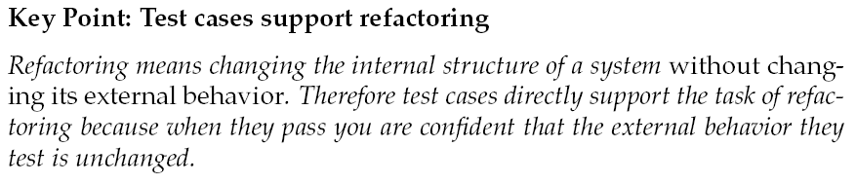
If it ain’t broke...
If it ain’t broke, don’t fix it
is the old saying of fear-driven programming
Developers and programmers do not dare doing drastic design and architecture changes in fear of odd side-effects.
CS @ AU
Henrik Bærbak Christensen

Slide 21
Test Ownership
Refactoring make developers want to have ownership of the tests:
Automatic tests is the developers’ means to be courageous and dare modify existing production code.
CS @ AU
Henrik Bærbak Christensen

Slide 22
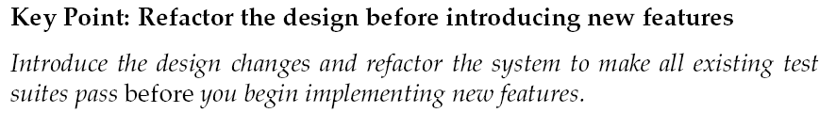

When redesigning....
TDD often seems like a nuisance to students and developers until the first time they realize that they dare do things they previously never dreamed of!
The first time a major refactoring is required – the light bulb turns on ☺
CS @ AU
Henrik Bærbak Christensen

Slide 23
War story
Kent and associates tell a story
  Business software with a many-to-many relation
    tedious to maintain and often give rise to errors
  However, is it really necessary?
    change to one-to-many relation and run all functional tests (costumer owned, defining end-user behaviour)
    All pass!
CS @ AU
Henrik Bærbak Christensen

Slide 24
Iteration 2
Betatown Rate Policy

Slide 25
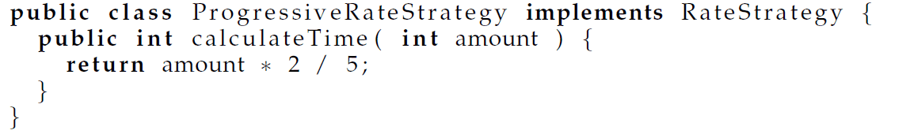
Triangulation at Algorithm Level
Introducing the real BetaTown rate policy is a nice example of using Triangulation
  Iteration 2
    Add test case for first hour => production code
  Iteration 3: Add test case for second hour
    Add just enough complexity to the rate policy algorithm
  Iteration 4: Add test case for third (and following) hour
    Add just enough more complexity
CS @ AU
Henrik Bærbak Christensen

Slide 26
Iteration 5
Unit and IntegrationTesting

Slide 27
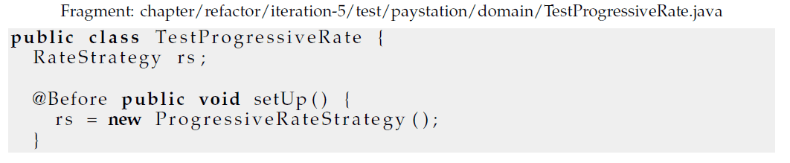
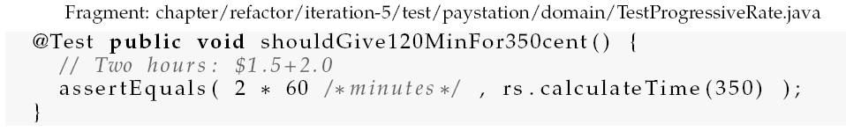
Separate Testing
I can actually test the new rate policy without using the pay station at all
CS @ AU
Henrik Bærbak Christensen

Slide 28
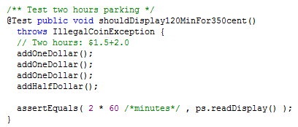

Advantages
The unit testing of the progressive rate strategy is much simpler than the corresponding test case, using the strategy integrated into the pay station.
Compare
CS @ AU
Henrik Bærbak Christensen

Slide 29
Testing Types
Now
  I test the ProgressiveRateStrategy in isolation of the pay station (Unit testing)
  The pay station is tested integrated with the LinearRateStrategy (Integration testing)
Thus the two rate strategies are tested by two approaches
  In isolation (unit)
  As part of another unit
And
  The actual Betatown pay station is never tested!
CS @ AU
Henrik Bærbak Christensen

Slide 30
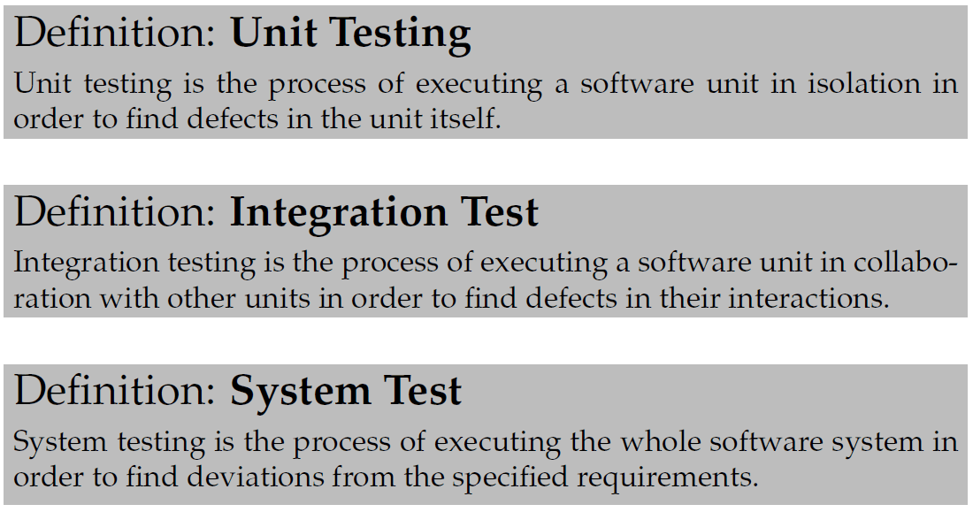
Definitions
Experience tells us that testing the parts does not mean that the whole is tested!
  Often defects are caused by interactions between units for wrong configuration of units!
CS @ AU
Henrik Bærbak Christensen

Slide 31
Exercise
Tricky – but
  Give me a concrete example where having tested all the units in isolation does not guaranty that the system works correctly!
  The Mars Climate Orbiter...
CS @ AU
Henrik Bærbak Christensen
Notes:
Mars Climate orbiter: two subsystems communicating, one using metric and one using non-metric. Crashing cost $125 mio dollars.

Slide 32
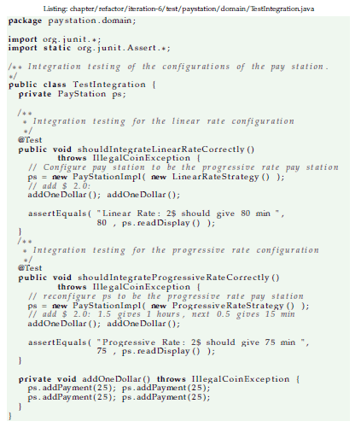
Integration Testing the Pay Station
I must add a testcase that validate that the AlphaTown and BetaTown products are correctly configured!
CS @ AU
Henrik Bærbak Christensen

Slide 33
More advanced integration testing
The pay station case’s integration is pretty simple as it is all a single process application.
Net4Care case
  Maven integration testing involves starting web server and running tests against it to validate realistic deployment.
CS @ AU
Henrik Bærbak Christensen

Slide 34
Iteration 6: Unit Testing Pay Station

Slide 35
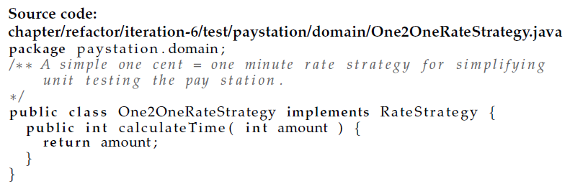
Separate Testing
I can actually also apply Evident Test to the testing of the pay station by introducing a very simple rate policy
CS @ AU
Henrik Bærbak Christensen

Slide 36
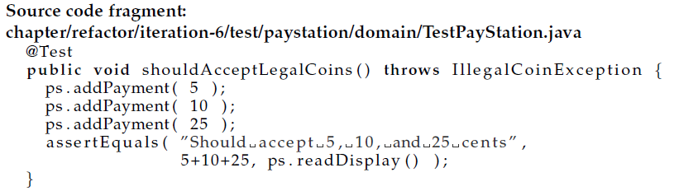
Resulting test cases
Using this rate policy makes reading pay station test cases much easier!
CS @ AU
Henrik Bærbak Christensen

Slide 37
Iteration 7: Suites in JUnit

Slide 38
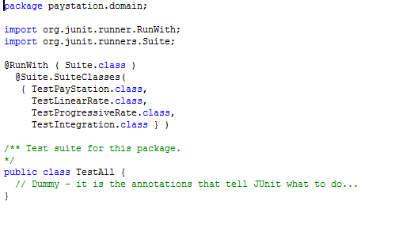

Suite
Suite = Set of test cases.
JUnit has special syntax to handle this, if you do not want to provide very long argument lists to JUnit.
CS @ AU
Henrik Bærbak Christensen

Slide 39
My preference today
I find the suite syntax of JUnit really weird.
Nowadays I prefer simply adding arguments to the ant target...
Maven
  Will run all java classes in folder ‘test’ as JUnit test cases...
    Exercise for the reader: Make Ant do the same ☺
CS @ AU
Henrik Bærbak Christensen

Slide 40
Outlook
System Testing

Slide 41
Testing levels
The normal classification is
  Unit testing: Individual software units
  Integration testing: unit collaborations
  System testing: User requirements
In our simple pay station, system testing is actually equal to the unit test of interface PayStation.
  In TDD all units tests pass all the time after an interation!!!
  System tests do not, but moves towards 100% as the product emerges over many iterations.
CS @ AU
Henrik Bærbak Christensen

Slide 42
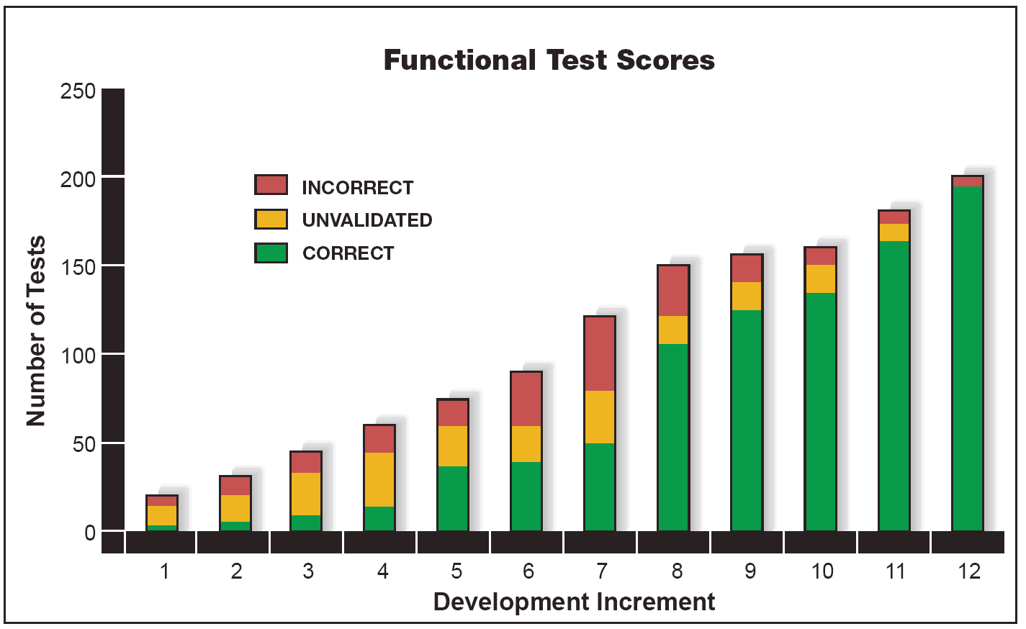
XP and TDD
Traditional Testing Terminology
  Unit testing, Integration Testing, System Testing
TDD:
  Unit tests
    Owned by developers
    Automatic
    Runs 100% all the time!
  Functional tests
    Owned by costumers
    Automatic
    Comprehensive and timely
    Public, to show progress
CS @ AU
Henrik Bærbak Christensen

Slide 43
Conclusion

Slide 44
Advice
Do not code in anticipation of need, code when need arise...
Automatic tests allow you to react when need arise
  because you dare refactor your current architecture...
CS @ AU
Henrik Bærbak Christensen

Slide 45
Refactoring
When ’architecture refactoring’ need arise then
A) Use the old functional tests to refactor the architecture without adding new or changing existing behaviour
B) When everything is green again then proceed to introduce new/modified behaviour
C) Review again to see if there is any dead code lying around or other refactorings to do.
CS @ AU
Henrik Bærbak Christensen
Notes:
Regarding C: In a project I did I changed the persistence structure from reading/writing flat files into internal datastructures to using a light-weight SQL database. After the refactoring there were several methods left from the interface that was geared at sequential reading the data into memory that was now of little use.

Slide 46
Discussion
These refactorings shown here are very local, so the ‘architecture decisions’ are also local.
However sometimes you need to make larger architectural changes that invalidate the test cases ☹
  Changing API or the way units are used
  Ex: Changing persistence from file to RDB based
What to do in this case?
CS @ AU
Henrik Bærbak Christensen
Notes:
No general rule – but keep in mind: Take small steps, and keep focus.
* Define a change path consisting of smaller tasks. Sometimes you may even be forced to implement stuff that you will need to remove later just to keep your test set running. However, some tests may become obsolete with the new architecture. They must of course be deleted.

